Slide 1
Problem Statement
It’s a van hire company called TopHire. It’s purely fictional of course. Their business system (HireBase) captures the rental information, including the customer information. HireBase has a fleet database where all vans are maintained. HireBase contains only 3 tables:
Customer: contains 100 customers, e.g. name, data of birth, telephone number, etc. A column called CustomerId uniquely identifies a customer.
Van: contains 20 vans that Top Hire operates. It’s their fleet. Contains the registration number, engine size, van size, colour, year of manufacture. The unique identifier for each van is the registration number.
Hire: contains 1000 hire transactions since 1st Jan 2011. Every hire transaction stores: who the customer was, which van was rented out, the date it occurred, number of days and various hire fees/charges (the van, sat nav, insurance, damage waiver and total bill). For each transaction we have Hire ID, which is a unique identifier in this table.

Slide 2
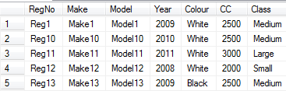
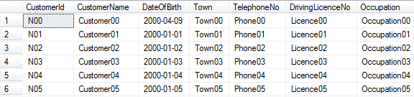
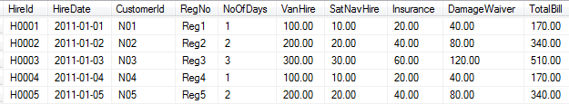
VAN Table
Customer Table
Hire Table

Slide 3
Data Warehouse
The data warehouse contains 4 tables:
Date dimension: contains every single date from 2006 to 2016.
Customer dimension: contains 100 customers. To be simple we’ll make it type 1 so we don’t create a new row for each change.
Van dimension: contains 20 vans. To be simple we’ll make it type 1 so we don’t create a new row for each change.
Hire fact table: contains 1000 hire transactions since 1st Jan 2011. It is a daily snapshot fact table so that every day we insert 1000 rows into this fact table. So over time we can track the changes of total bill, van charges, satnav income, etc.

Slide 4
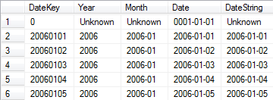
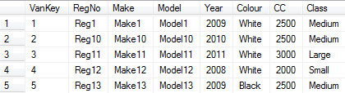
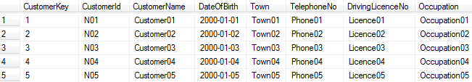

Date Dimension
Van Dimension
Customer Dimension
Fact Table

Slide 5
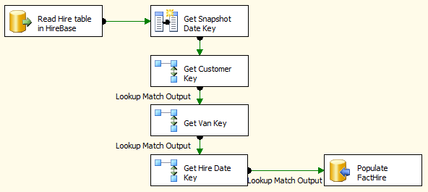
Build the SSIS Package to Populate the Fact Table
2.Get Snapshot Date Key: we get today’s date and convert it into an integer as Snapshot Date Key. FactHire is a snapshot fact table. “Snapshot Date”. Meaning: the date when we captured the source table. Or, the date when these 1000 rows were inserted into this fact table. The value of this snapshot date is today’s date (the date the ETL runs). The date the load happens.
3.Get Customer Key: from Hire table we get the Customer ID which was involved in the hire transaction. We then go to the Customer Dimension to get the Customer Key for this Customer ID.
1.Read Hire table in HireBase: First we get the original OLTP records from the hire table in HireBase.
4.Get Van Key: from Hire table we get the Registration Number which was rented out in the transaction. We then go to the Van Dimension to get the Van Key for this Registration Number.
5.Get Hire Date Key: from Hire table we get the Hire Date, which is the date when the hire transaction happened. We then go to the Date Dimension to get the Date Key for this Hire Date.
6.Populate FactHire: After we get all the required dimension keys, we insert the rows into the FactHire fact table.

Slide 6
Read Hire table in HireBase
Get Snapshot Date Key-(DT_I4) ((DT_WSTR,4) YEAR(GETDATE()) + RIGHT( "0" + (DT_WSTR,2) MONTH(GETDATE()) , 2 ) + RIGHT( "0" + (DT_WSTR,2) DAY(GETDATE()) , 2 ))
Get Customer Key-OLE DB connection manager: a table in the warehouse TopHireDW (in this case it’s DimCustomer), see Connection pane below: In the Columns pane, connect Customer Id from the Hire table to the Customer Id on the DimCustomer table, and bring the CustomerKey as output
Select dw- TopHireDW -select Dim Customer –map customer id and Customer id
4. Get Van Key-When connecting [Get Customer Key] and [Get Van Key]
Select dw- TopHireDW -select Dim VAN –map Customer Key and VAN KEY
Get Hire Date Key- Select dw- TopHireDW---- select DateKey, Year, Month, convert(date, Date) as Date from DimDate
map Hire date to date
Populate FactHire-It’s OLE DB destination. On the Connection Manager pane, specify FactHire as the target table, and leave everything as IT is.
Select dw- TopHireDW- FactHire

Slide 7
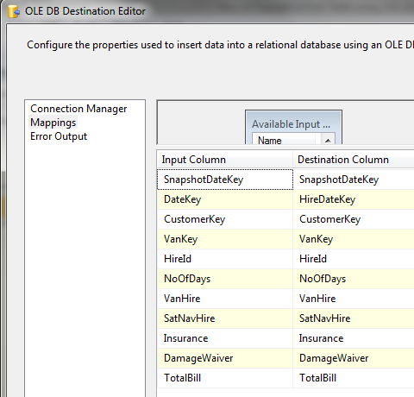

Slide 8
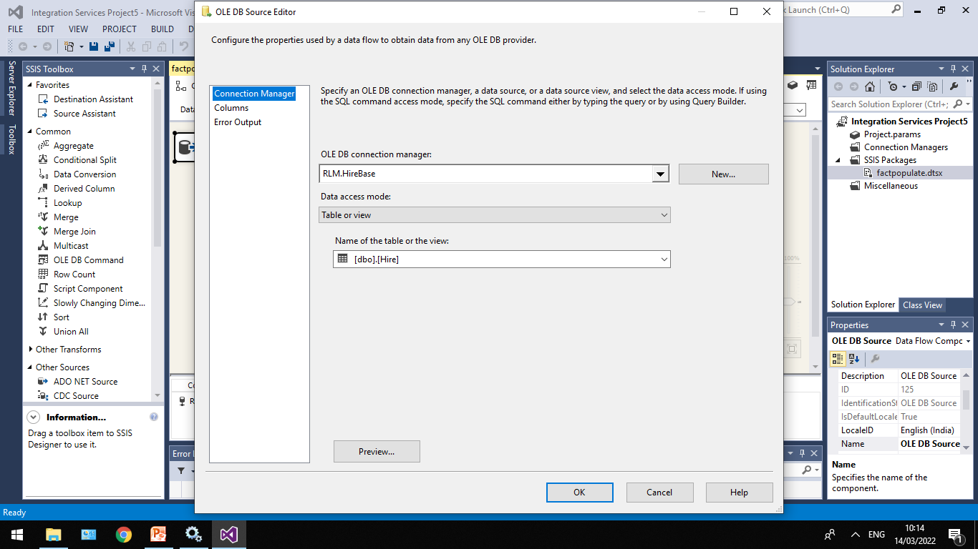

Slide 9
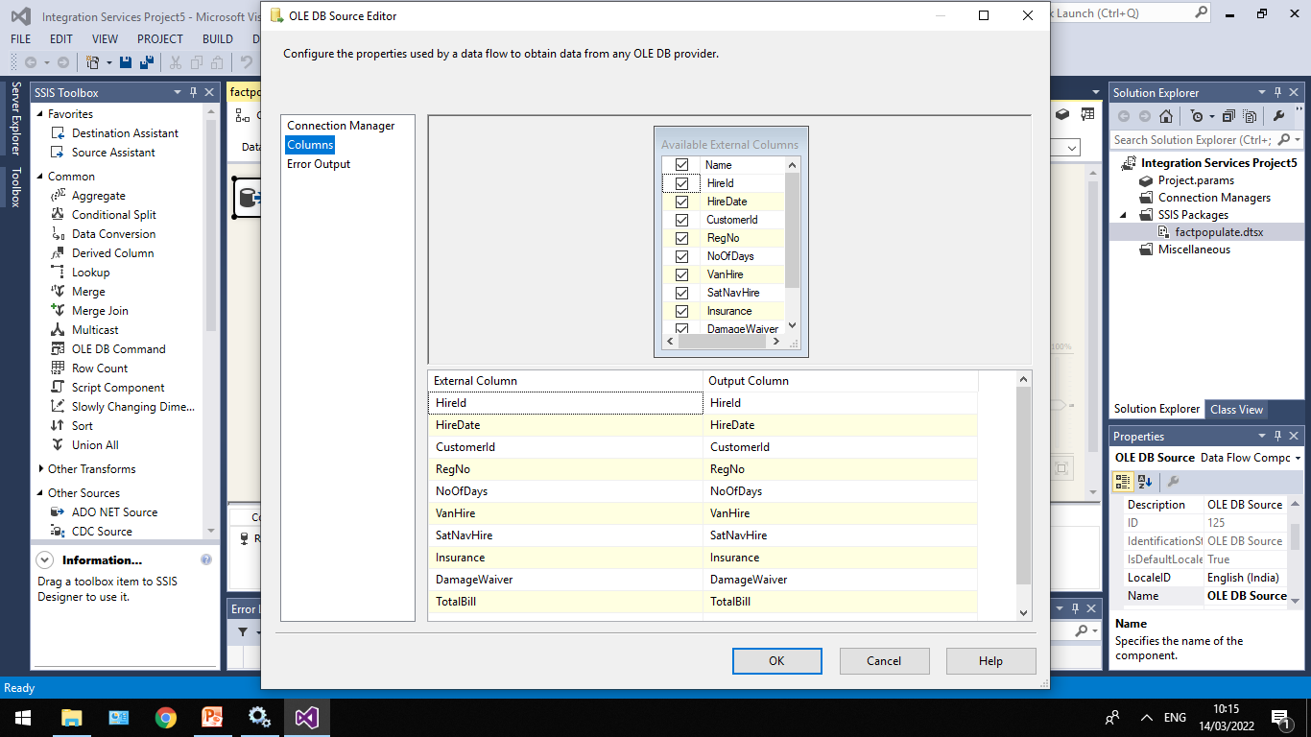

Slide 10
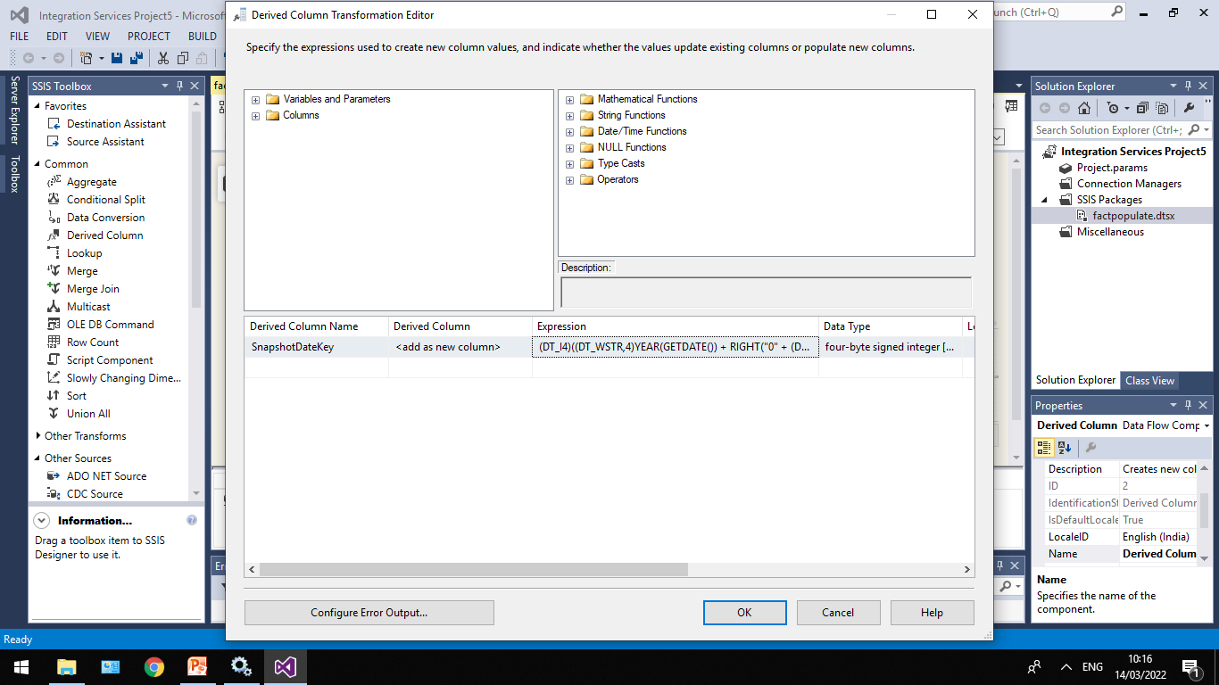
(DT_I4)((DT_WSTR,4)YEAR(GETDATE()) + RIGHT("0" + (DT_WSTR,2)MONTH(GETDATE()),2) + RIGHT("0" + (DT_WSTR,2)DAY(GETDATE()),2))

Slide 11
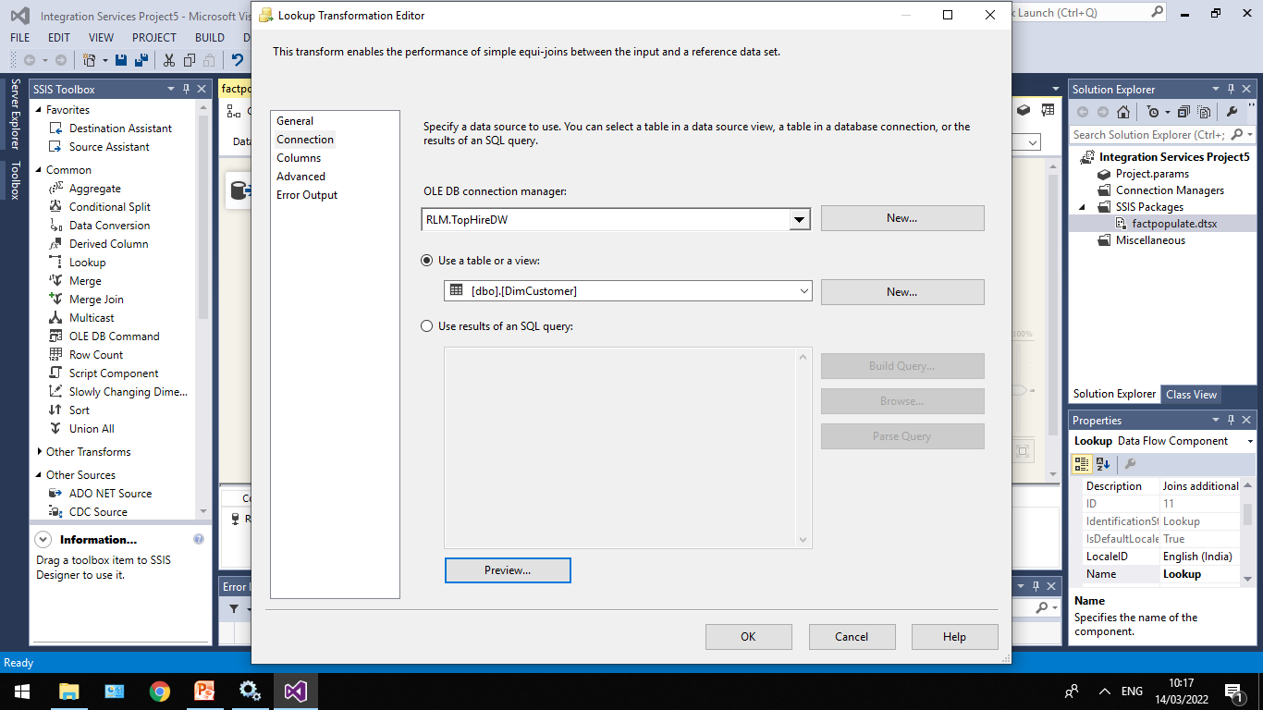

Slide 12
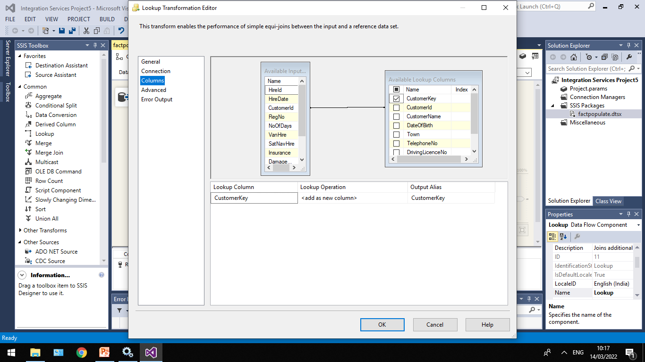

Slide 13
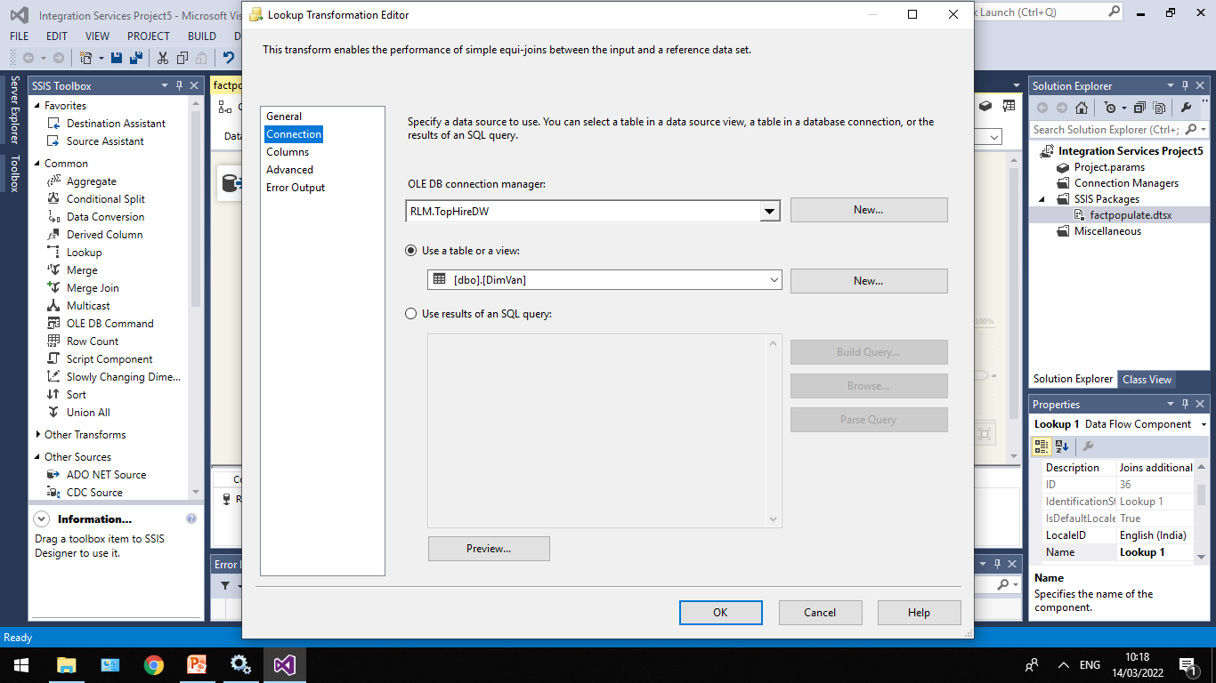

Slide 14
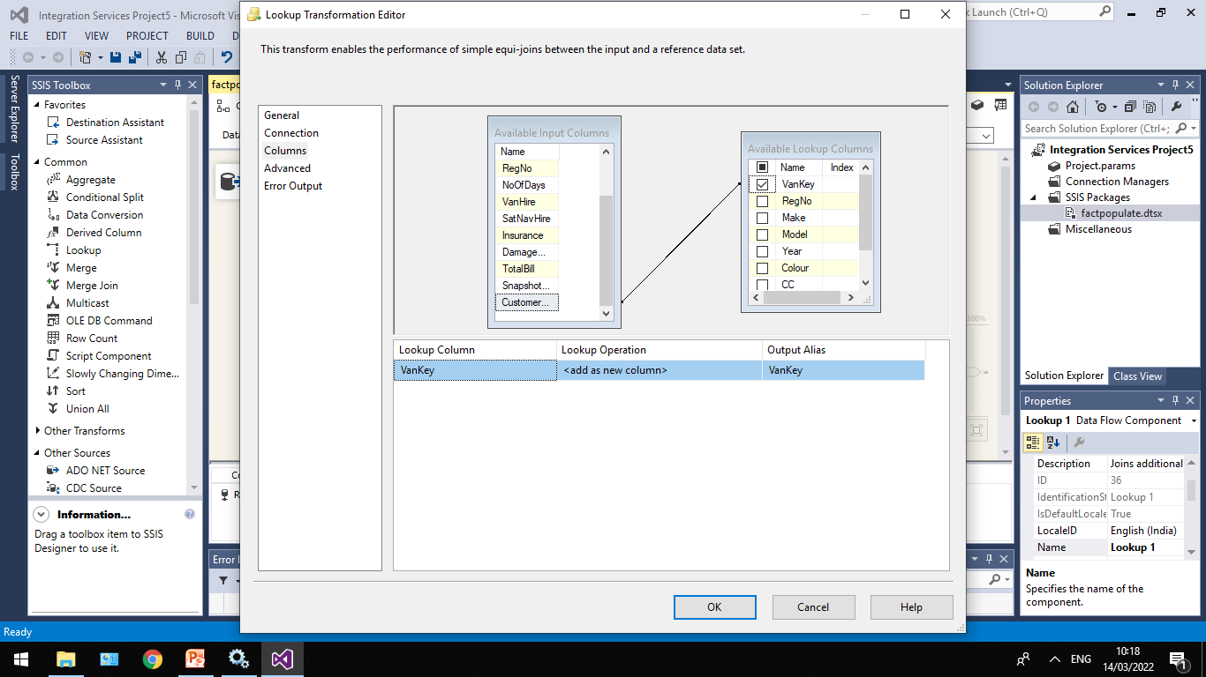

Slide 15
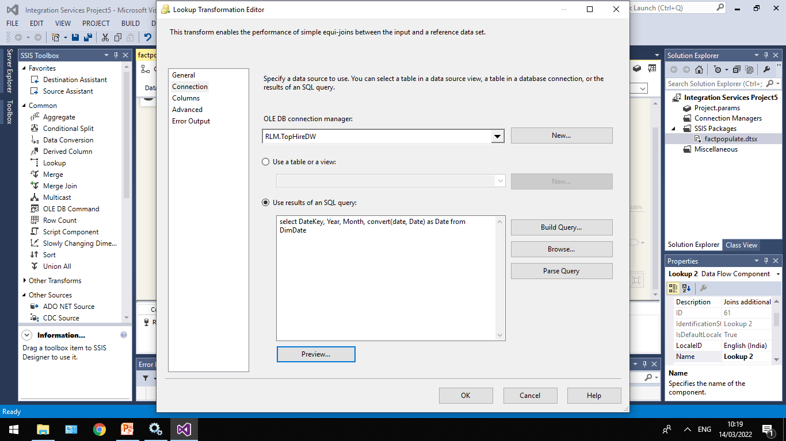

Slide 16
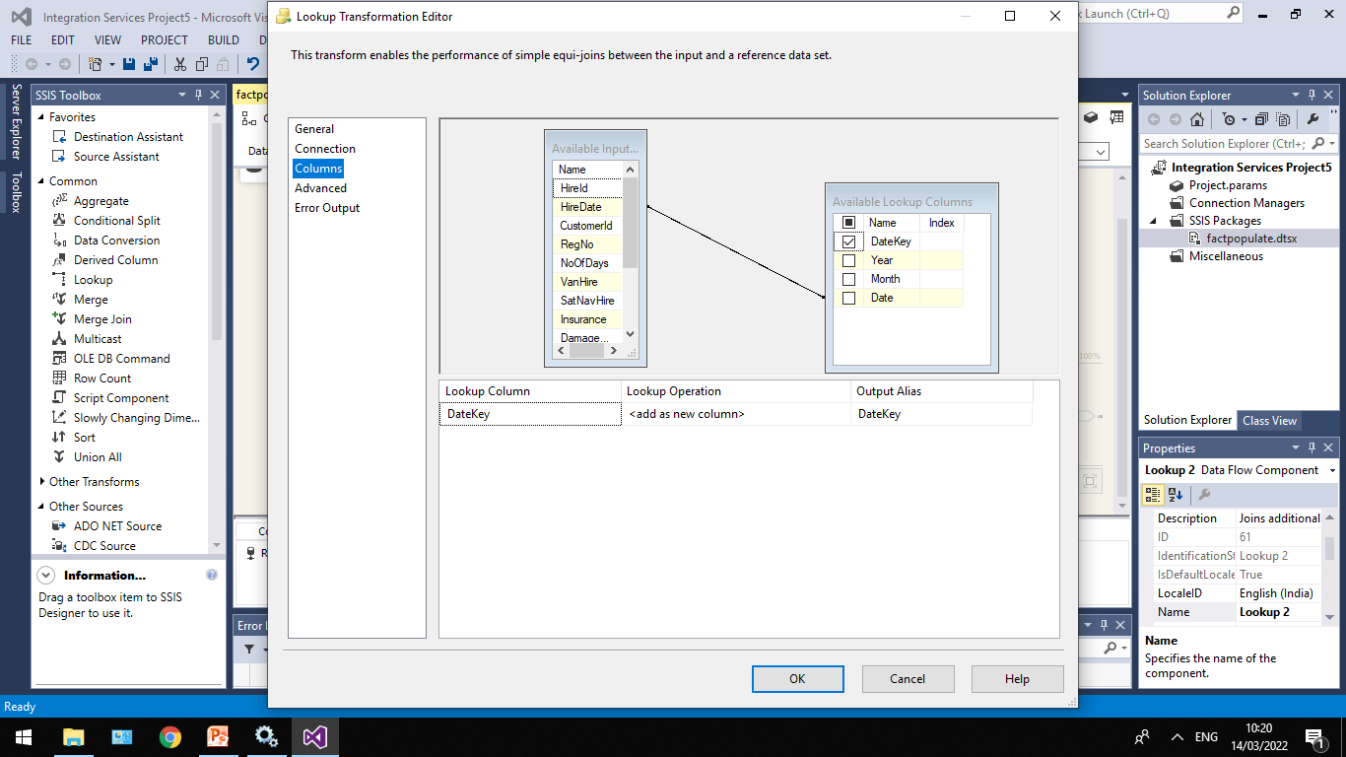

Slide 17
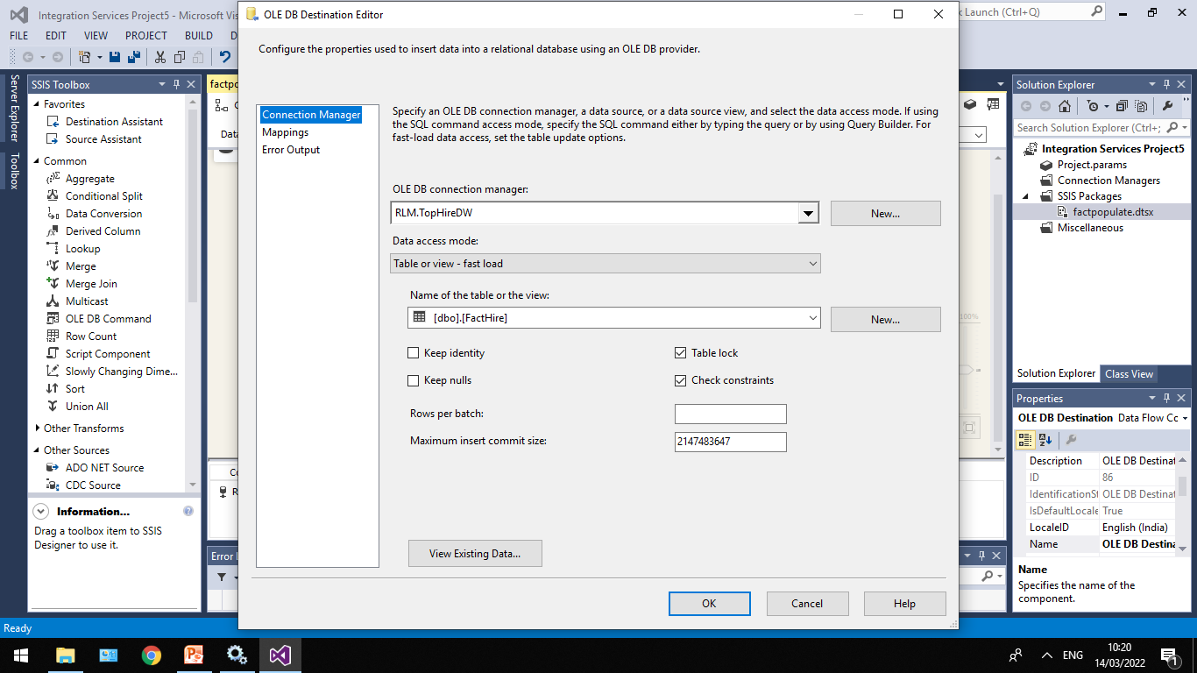

Slide 18
